Slide 1
Udacity Connect Session
March 17, 2018
Supervised Learning - Classification
github.com/Udacity/machine-learning/p ..

Slide 2
Welcome back!

Slide 3
Morning Schedule
10:00 - 10:30 | Housekeeping, Review
10:30 - 11:00 | Overview of Classification
11:00 - 11:30 | Free Discussion
11:30 - noon | Bayesian Inference
© 2016 Udacity. All rights reserved.

Slide 4
Mar 10 | Supervised Learning | Unit 2 - Lessons 9 - 14 Finish the following modules under Supervised Learning : ● Math Behind SVMs, SVMs in practice ● Instance Based Learning ● Naive Bayes, Bayesian Learning, Bayesian Inference ● Ensemble B&B Do not do Bayes NLP Mini-Project lesson as this will be covered in session next week. Review the Finding Donors for CharityML project.

Slide 5
Review
ML FOUNDATIONS REVIEW
Supervised Learning - Regression
Problems with continuous inputs and outputs
Linear/Multivariate Regression
Regularization
Stochastic Gradient Descent
© 2016 Udacity. All rights reserved.

Slide 6


Overfitting in Regression
REGULARIZATION
Add a penalty for complexity to cost function
L1 Regularization - Ridge Regression
L2 Regularization - Lasso Regression
© 2016 Udacity. All rights reserved.

Slide 7
Stochastic Gradient Descent
HANDLES OUT-OF-CORE AND ONLINE LEARNING
Updates weights during the gradient calculation
Mini-batches
Convergence is no longer guaranteed
When it does work, it can be much faster overall

Slide 8
Classification Problems
Email spam classifier
Sentiment Analysis
Image recognition
Cancer detection
Online transactions - fraud (anomaly) detection
Binary classification - two output classes {0, 1}
Multiclass classification - many output classes {0, 1, .. N}

Slide 9
Classification Algorithms
ML FOUNDATIONS REVIEW
Supervised Learning -- Classification
Decision Trees
KNN
Artificial Neural Networks (ANN)
Logistic/Ridge Regression
Support Vector Machines (SVM)
Probabilistic Models (Bayesian Learning)
© 2016 Udacity. All rights reserved.
Notes:
https://docs.microsoft.com/en-us/azure/machine-learning/studio/algorithm-cheat-sheet

Slide 10
Decision Trees
CLASSIFICATION
Entropy -p log (p)
Information Gain
ID3

Slide 11
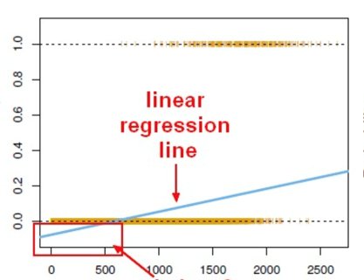
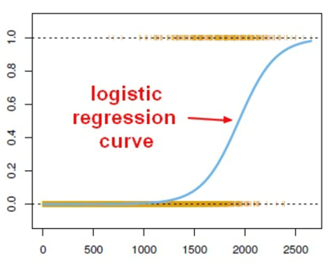
Regression for Classification?
BINARY CLASSIFICATION
Source: https://gerardnico.com/wiki/data_mining/simple_logistic_regression

Slide 12
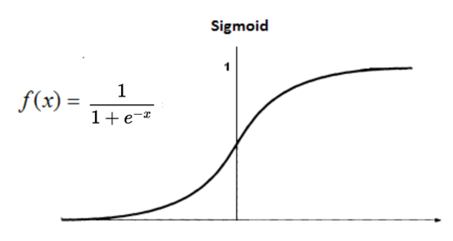
Logistic Regression
Andrew Ng https://www.youtube.com/watch?v=-la3q9d7AKQ
Sigmoid or logistic function
0 < output < 1
Nonlinear
Interpret as probability
Threshold for classification

Slide 13


Cost Function
LOGISTIC REGRESSION
y = w₁x + w₀
_{Squared Error}
_{MSE}
Notes:
Log loss equation = squared error ‘cost’ function

Slide 14
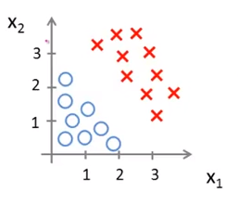
Decision Boundary
CLASSIFICATION
y = w₂x₂ + w₁x₁ + w₀
Weights define a line that best separates the classes
Doesn’t work when class distributions are not linearly separable

Slide 15
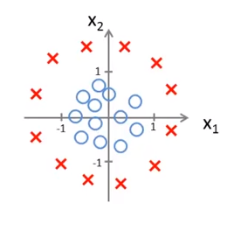
Nonlinear Decision Boundary
https://www.youtube.com/watch?v=HIQlmHxI6-0
y = w₁x₁ + w₂x₂ + w₃x₁² + w₄x₂² + w₀
Notes:
y = w₁x₁ + w₂x₂ + w₃x₁² + w₄x₂² + w₀ (this is the WTX value used for the prediction)
w₃x₁² + w₄x₂² : these terms are called feature engineering

Slide 16
Feature transformation
RE-ENGINEER THE VARIABLES SO THAT PROBLEM IS SIMPLIFIED
Switch (transform) to polar coordinates r, and θ
r = sqrt(x₁² + x₂²), θ = tan⁻¹(x₂/x₁)
y = w’₁r + w’₂θ + w₀ - “linearly separable”

Slide 17
Lunch Break

Slide 18
Afternoon Session
1:00 - 1:30 | Introduction to Bayes Rule
1:30 - 2:30 | Notebook Session
2:30 - 2:50 | Review Notebook
2:50 - 3:15 | Recap, Lookahead and Feedback
3:15 - 5:00 | Work on Project 1 or P2
© 2016 Udacity. All rights reserved.

Slide 19
Probabilities
The probability of an event A is the number of ways event A can occur divided by the total number of possible outcomes. P(A)
B
A

Slide 20
Joint Probabilities
UNBIASED COIN FLIP
P(A) = P(B) = 0.5, P(A ∩ B) = P(A)*P(B)
A | B | P(A,B)
H | H | 0.25
H | T | 0.25
T | H | 0.25
T | T | 0.25
A
B

Slide 21
Conditional Probabilities
BAYES RULE
P(A|B) = P(A∩B)/P(B)
P(A∩B) = P(A|B) * P(B)
P(A∩B) = P(B|A) * P(A)
P(A|B) = P(B|A) * P(A) / P(B)
A
B

Slide 22
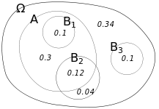
Example
EULER DIAGRAM
P(A) = ?
P(A|B₁) = ?
P(A|B₂) = ?
P(A|B₃) = ?
Notes:
P(A) = 0.3+0.1+0.12 = 0.52
P(A|B₁) = 0.1/0.1 = 1
P(A|B₂) = 0.12/0.16 = 0.75
P(A|B₃) = 0/0.1 = 0

Slide 23
Terminology
•P(A | B): posterior; how probable is hypothesis (A) given evidence (B)
•P(B | A): likelihood; how probable is the evidence given that our hypothesis is true
•P(A): prior probability; how probable is our hypothesis before observing the evidence
•P(B): marginal likelihood; how probable is the evidence under all hypotheses

Slide 24

Bayes Rule
P(s|X) = P(s| x₁, x₂, .., x_{k}) = P(x₁, x₂, .., x_{k}|s) * P(s) / P(x₁, x₂, .., x_{k})
P(s| x₁, x₂, .., x_{k}) ∝ P(x₁|s) * P(x₂|s) * .. * P(x_{k}|s) * P(s)

Slide 25
Naive Bayes
Advantages
Easy to implement and is very efficient
Performs well despite simplicity and naive assumption
Can handle large feature space
Can handle large datasets
Can handle multiclass classification directly
Disadvantages
- Naive assumption may not hold for dataset

Slide 26
github.com/Udacity/machine-learning/projects/
practice_projects/naive_bayes_tutorial/
Bayesian_Inference

Slide 27
Ensemble Learning
Ensemble Learners
https://www.youtube.com/watch?v=Un9zObFjBH0
Bootstrap Aggregating https://www.youtube.com/watch?v=2Mg8QD0F1dQ
Gradient Boosting https://www.youtube.com/watch?v=GM3CDQfQ4sw&t=24s

Slide 28
Prep for next week
Submit Donors for Charity Project
Supervised Learning Unit - Ensemble Methods
Unsupervised Learning - Clustering, Feature Scaling

Slide 29
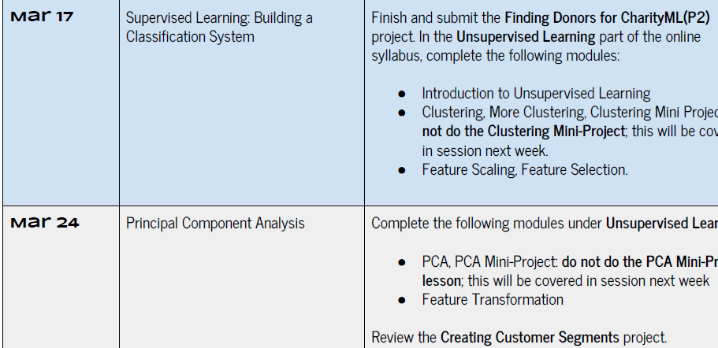

Slide 30

We really need your Feedback!
© 2016 Udacity. All rights reserved.

